Slide 2
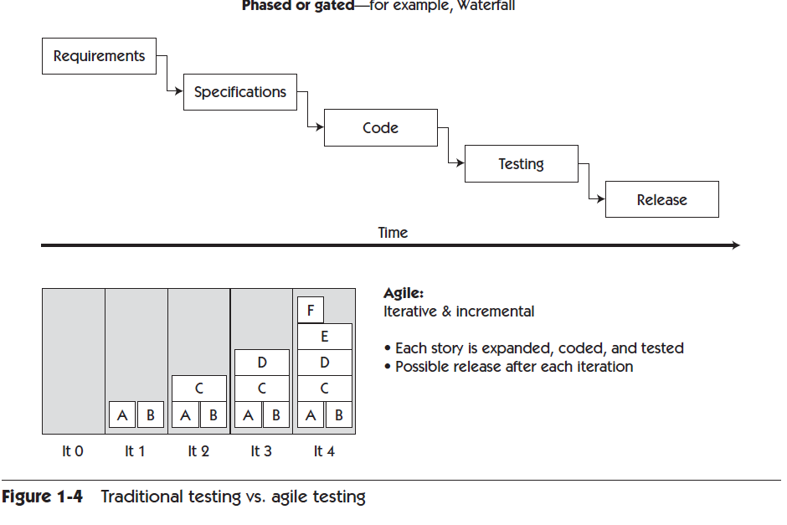
Traditional vs Agile Projects
From Agile Testing by Lisa Crispin & Janet Gregory (2009) p.13

Slide 3
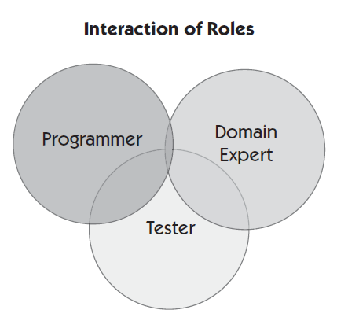
Whole team approach
Everyone is responsible for quality
Testing is not just something a tester does
The system is designed and coded for testability
There is constant collaboration between team members
From Agile Testing by Lisa Crispin & Janet Gregory (2009) p.8

Slide 4
Differences between traditional and agile
Typical differences between traditional and agile software testing:
Traditional Software Testing | Agile Software Testing
Functionality tested in larger pieces (from requirements) | Functionality tested in small pieces (from stories)
Requirements more stable, and more rigorous change control process | Stories more likely to change as project progresses, lighter change control
Functionality ready to test towards the end of project | Functionality ready to test throughout the project
Manual acceptance tests conducted as a final check | Acceptance tests automated and used to drive development process
Limited automated testing | Strong focus on test driven development: automated unit & integration tests
Focus on detailed scripted manual testing | Focus on exploratory manual testing for stories

Slide 5
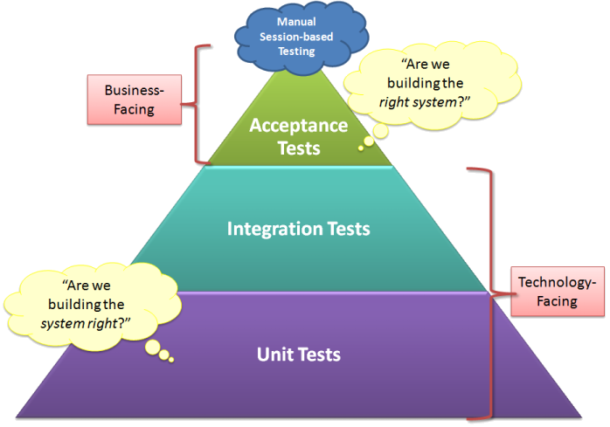
Key testing activities & process flows
Automated Acceptance Testing: Are we building the right system?
Manual Session Based Testing: Exploratory testing to ensure we are doing automated testing right

Slide 6
Agile Testing Process
Define user story
Define Acceptance Criteria
Define Acceptance Tests
Unit Tests
Develop User-Story
Integration Tests
Automate Acceptance Tests
Review Test Results
Session Based Testing
Passing Acceptance Tests
Agile Testing Process
Legend
Tester
BA
Developer
Customer

Slide 7
Automated Acceptance Testing
Automated Acceptance Tests are specified by anyone as acceptance criteria: in business terms – to ensure visibility – to answer the question: “Are we building the right system?”
Given something is already done, When I do something, Then I expect something
These acceptance tests are automated by technical testers and developers
Only acceptance criteria are automated – detailed testing conducted via unit/integration tests and session based testing
These automated acceptance tests should be automatically run against all new builds (continuous integration) – to ensure system doesn’t regress

Slide 8
Automated Acceptance Testing – Example Acceptance Criteria
@2.1
Feature: Request Feedback
As a feedback requestor
I want to send an email to request feedback by a particular date
So that feedback is given for a review period
Background:
Given I am logged on as a Feedback Requestor
And I click on Talent Management Dashboard
And I click on the first staff review
And I click on Request Feedback
@success @done
Scenario: Request feedback for a specific employee shows employee's name
Given the feedback requestor is on the feedback request page
Then I should see the employee's name displayed
@success @done
Scenario: Relationship type contains the correct options
Given the feedback requestor is on the feedback request page
When I select a valid relationship type
Then the relationship type includes the following options:
| Options |
| External |
| Internal |

Slide 9
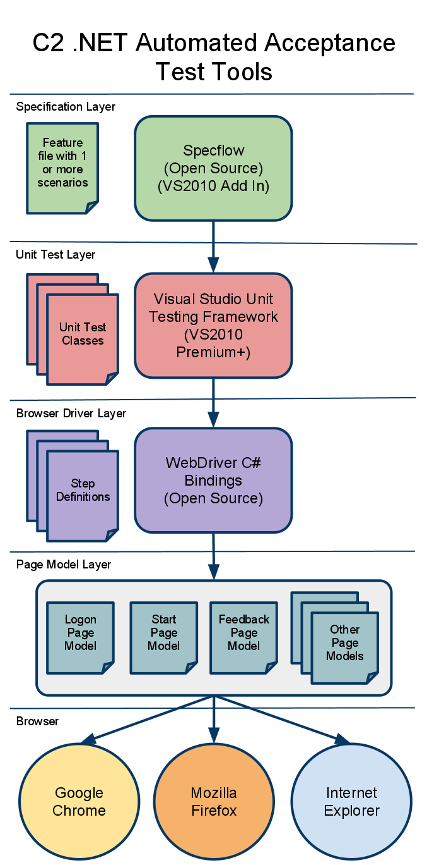
C2 .NET Automated Test Tools
Specification Layer: SpecFlow
Unit Test Layer: VisualStudio Unit Testing (MSTest)
Browser Driver: WebDriver
Page Model: Custom
Browsers Supported: Chrome, Firefox, Internet Explorer

Slide 10
Page objects
Page objects are a representation of an application page to ensure maintainability
Contain elements and methods
Step definitions interact with pages
Makes tests easier to maintain

Slide 11
What is session based testing?
Session based testing is a form of structured, targeted exploratory testing.
Exploratory testing is simultaneous learning, test design, and test execution
The outcome is better automated tests – as it provides a quick feedback loop
How do we ensure it is not just ‘playing with the system’?
Charters are used to guide sessions, which are constrained in time (typically 1-2 hours).
Heuristics (guiding principles) are used to plan what is covered in a session.
Metrics are collected for each session (focus area, time, breakdown tasks).
Lightweight Reports are prepared, and the project team is debriefed

Slide 12
Benefits of Session Based Testing
As functionality is delivered in smaller pieces throughout agile projects, change is more likely, and automated tests more prevalent:
Benefits of Session Based Testing
Less Preparation is Required Heuristics are used to plan the session close to when it happens. The session is simultaneous learning, test design and execution.
Important bugs are found quickly As there is less emphasis on a script, the tester can focus on problematic areas and use intuition and deductive reasoning to find important bugs sooner than typical scripted testing.
Testing is more intellectually challenging at execution time Following reasoning and using judgement is more intellectually challenging than following a script

Slide 13
Disadvantages of Session Based Testing
Disadvantages of Session Based Testing | Mitigation Strategies
Difficult to reproduce test cases As tests are conducted in an exploratory manner, there is no ‘script’ to reproduce test cases | Use Microsoft Test Manager to ‘record’ session based testing sessions, and use this to generate documentation from the action recording.
Test cases can’t be reviewed in advance As tests are created during the session, these can’t be reviewed prior | Ensure the session based testing report details what was tested, and project team is debriefed on outcomes of session based testing to ensure test coverage. Ensure automated tests are reviewed for test coverage.
Session Based Tests are not exhaustive As sessions are limited in time, these therefore may not cover everything that needs to be tested | Ensure automated tests are developed and executed regularly to test major functionality of the application. Schedule additional sessions to target known problem areas

Slide 14
A typical session based testing process
Story or Function Complete
Debrief with Project Team
Past
Results
Obstacles
Outlook
Feelings
Create lightweight report:
# Sessions
# Problems
Functional Areas
Environment
Unit & Integration Tests Passed
✓
Conduct session based testing
Create test in MS Test Manager, execute using ‘record actions’
Automated Acceptance Tests Passed
✓
Determine guiding principles for session based testing (SFDPO)
Decide on session based testing charter:
focus & participants

Slide 15
Questions?

